Slide 1
UNIT 1: Introduction UNIT 2: Architecture
Shaila Mitra Neupane| KBS,Kathmandu
BCA 6th Sem

Slide 2
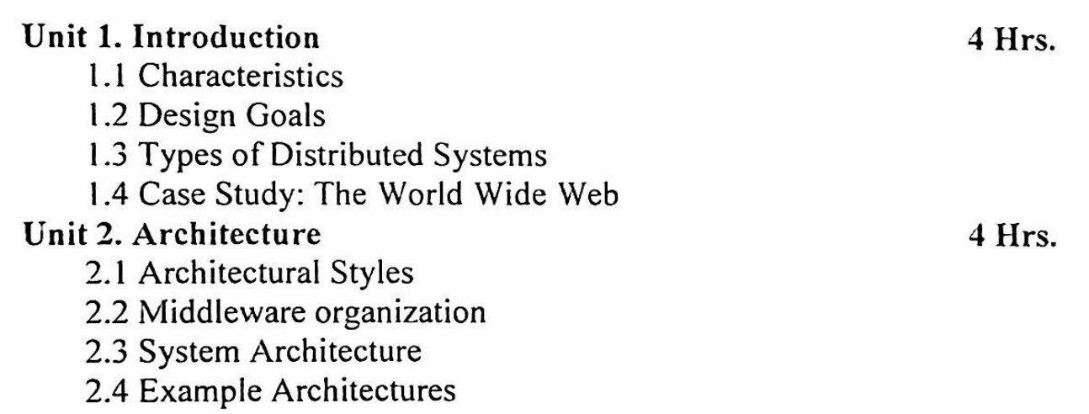

Slide 3
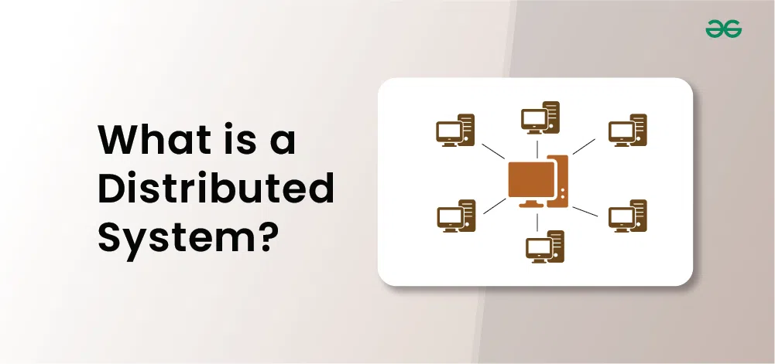
A distributed System is a collection of autonomous computer systems that are physically separated but are connected by a centralized computer network that is equipped with distributed system software.
The autonomous computers will communicate among each system by sharing resources and files and performing the tasks assigned to them.

Slide 4
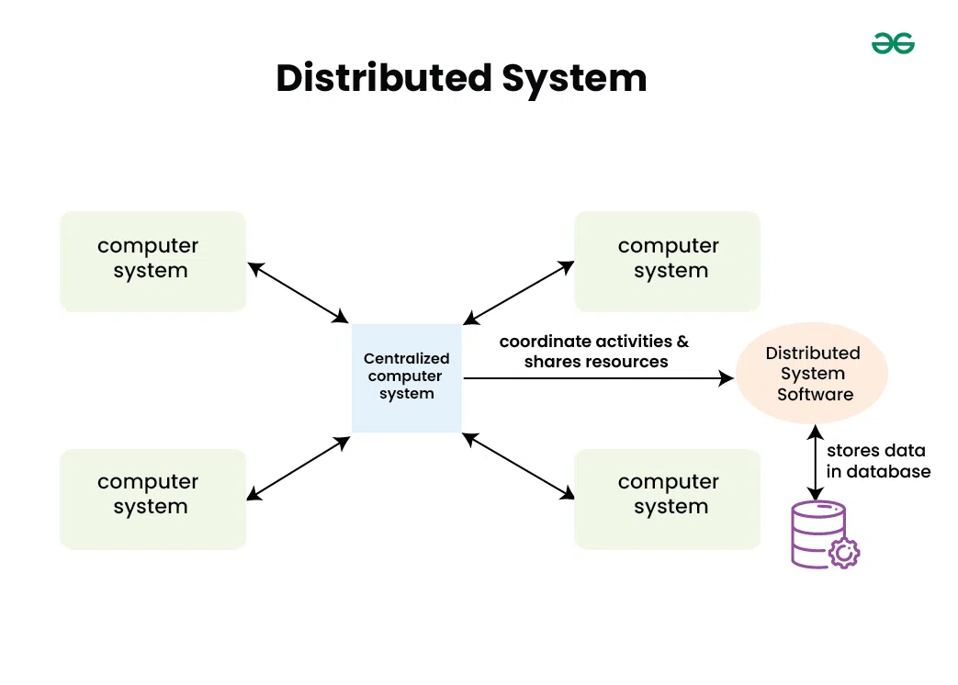
Example of a Distributed System
Any Social Media can have its Centralized Computer Network as its Headquarters and computer systems that can be accessed by any user and using their services will be the Autonomous Systems in the Distributed System Architecture.
Distributed System Software: This Software enables computers to coordinate their activities and to share the resources such as Hardware, Software, Data, etc.
Database: It is used to store the processed data that are processed by each Node/System of the Distributed systems that are connected to the Centralized network.

Slide 5
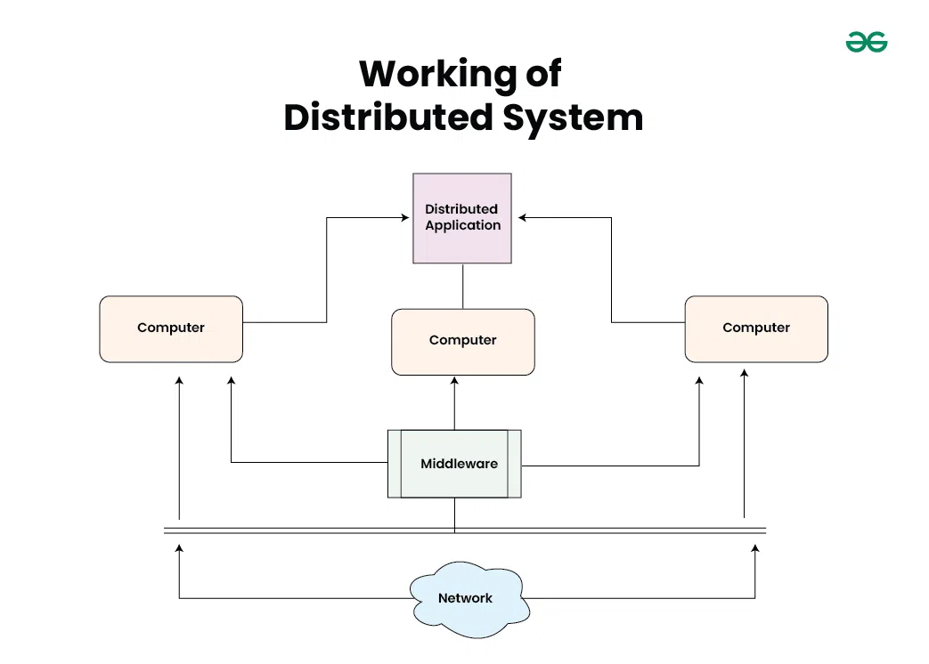

Slide 6
As we can see that each Autonomous System has a common Application that can have its own data that is shared by the Centralized Database System.
To Transfer the Data to Autonomous Systems, Centralized System should be having a Middleware Service and should be connected to a Network.
Middleware Services enable some services which are not present in the local systems or centralized system default by acting as an interface between the Centralized System and the local systems. By using components of Middleware Services systems communicate and manage data.
The Data which is been transferred through the database will be divided into segments or modules and shared with Autonomous systems for processing.
The Data will be processed and then will be transferred to the Centralized system through the network and will be stored in the database.

Slide 7
Types of Distributed System
Client-server systems: The most traditional and simple type of distributed system, involves a multitude of networked computers that interact with a central server for data storage, processing, or other common goal.
Peer-to-peer networks: They distribute workloads among hundreds or thousands of computers all running the same software.
Cell phone networks: It is an advanced distributed system, sharing workloads among handsets, switching systems, and internet-based devices.
The most common forms of distributed systems today operate over the internet, handing off workloads to dozens of cloud-based virtual server instances that are created as needed, and then terminated when the task is complete.

Slide 8
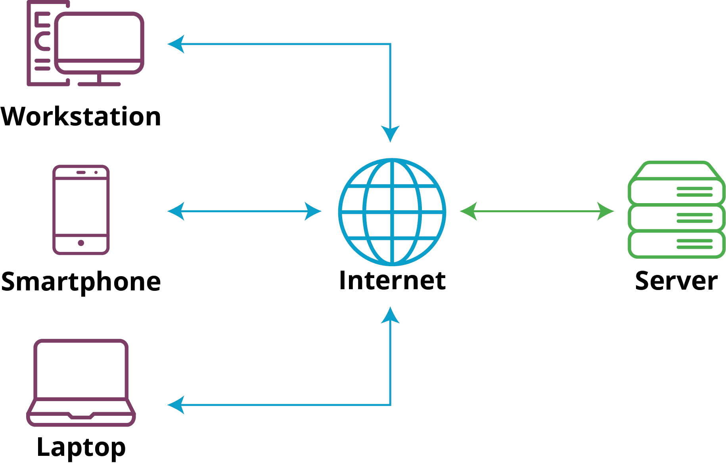
Client-Server Architecture

Slide 9
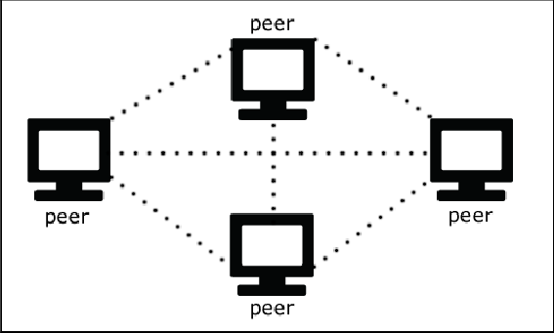
Peer-To-Peer architecture

Slide 10
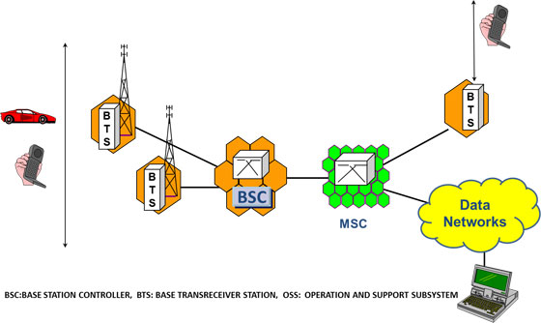
Cellular Network Architecture

Slide 11
Characteristics of Distributed System
Resource Sharing: It is the ability to use any Hardware, Software, or Data anywhere in the System.
Openness: It is concerned with Extensions and improvements in the system (i.e., How openly the software is developed and shared with others)
Concurrency: It is naturally present in Distributed Systems, that deal with the same activity or functionality that can be performed by separate users who are in remote locations. Every local system has its independent Operating Systems and Resources.
Scalability: It increases the scale of the system as a number of processors communicate with more users by accommodating to improve the responsiveness of the system.
Fault tolerance: It cares about the reliability of the system if there is a failure in Hardware or Software, the system continues to operate properly without degrading the performance the system.
Transparency: It hides the complexity of the Distributed Systems to the Users and Application programs as there should be privacy in every system.
Heterogeneity: Networks, computer hardware, operating systems, programming languages, and developer implementations can all vary and differ among dispersed system components.

Slide 12
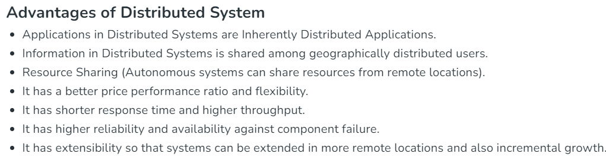
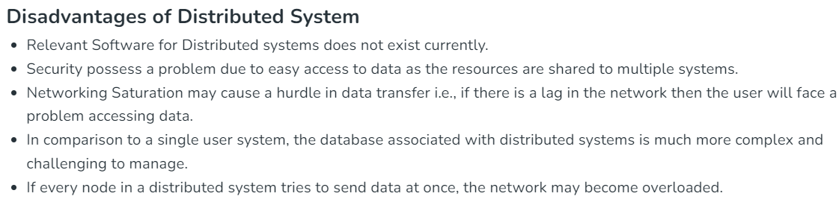

Slide 13
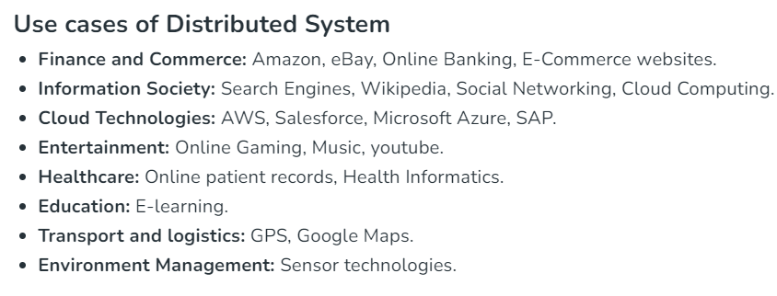
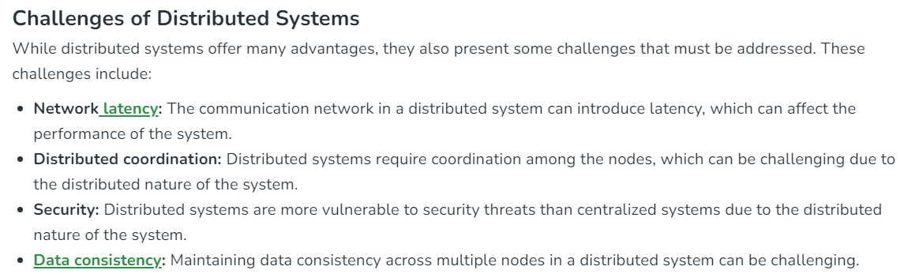

Slide 14
Architecture Styles in Distributed Systems
Distributed systems are a set of autonomous computers that appears to be a single coherent system to its users from outside. There are actually two different types of systems that exist in prospective of computers:
Centralized System :
A centralized system consists of a single machine.
All calculations are done by a particular computer.
Its performance is low as the workload is not divided.
There is also no machine present in backup if the original computer system fails.
Distributed Systems :
A distributed system consists of multiple machines.
All computation work is divided among the different systems.
Its performance is high as the workload is divided among different computers to efficiently use their capacity.
There are systems present in backup, so if the main system fails then work will not stop.

Slide 15
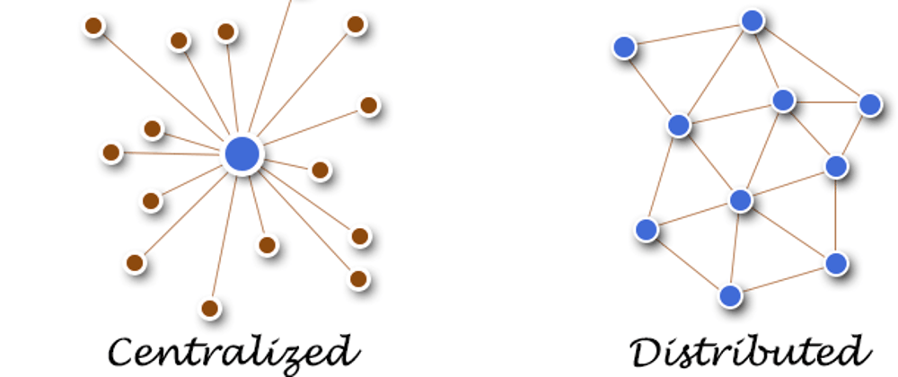

Slide 16
Architecture Styles: To show different arrangement styles among computers Architecture styles are proposed.
Layered Architecture:
In Layered architecture, different components are organized in layers. Each layer communicates with its adjacent layer by sending requests and getting responses. The layered architecture separates components into units. It is an efficient way of communication. Any layer can not directly communicate with another layer. A layer can only communicate with its neighboring layer and then the next layer transfers information to another layer and so on the process goes on.
In some cases, layered architecture is in cross-layer coordination. In a cross-layer, any adjacent layer can be skipped until it fulfils the request and provides better performance results. Request flow from top to bottom(downwards) and response flow from bottom to top(upwards). The advantage of layered architecture is that each layer can be modified independently without affecting the whole system. This type of architecture is used in Open System Interconnection (OSI) model.
To the layers on top, the layers at the bottom offer a service. While the response is transmitted from bottom to top, the request is sent from top to bottom. This method has the advantage that calls always follow a predetermined path and that each layer is simple to replace or modify without affecting the architecture as a whole.

Slide 17
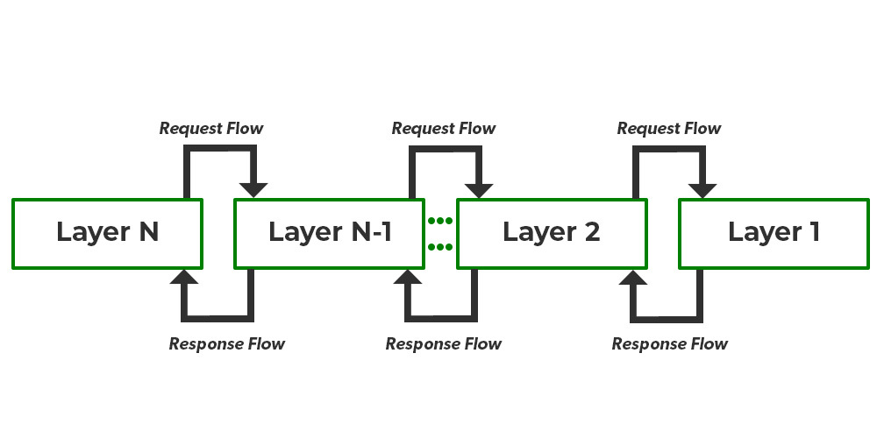

Slide 18
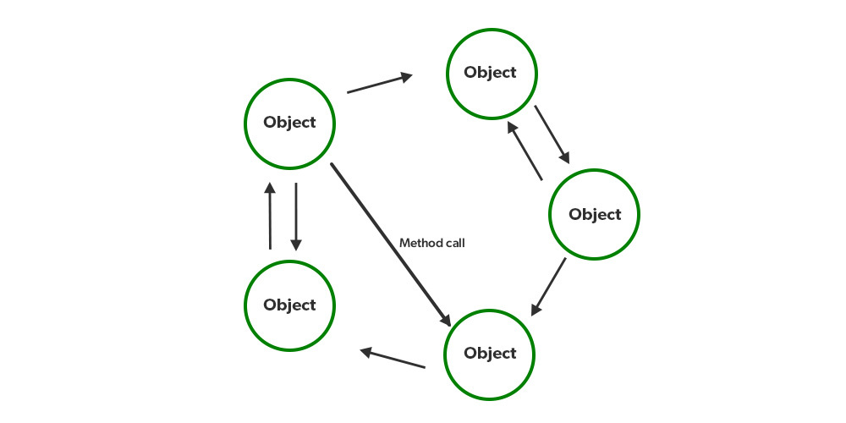
Object-Oriented Architecture:
In this type of architecture, components are treated as objects which convey information to each other. Object-Oriented Architecture contains an arrangement of loosely coupled objects. Objects can interact with each other through method calls. Objects are connected to each other through the Remote Procedure Call (RPC) mechanism or Remote Method Invocation (RMI) mechanism.
Web Services and REST API are examples of object-oriented architecture. Invocations of methods are how objects communicate with one another. Typically, these are referred to as Remote Procedure Calls (RPC). REST API Calls, Web Services, and Java RMI are a few well-known examples. These characteristics apply to this.

Slide 19
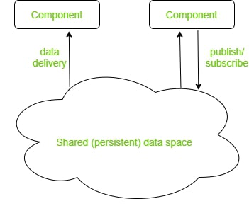
Data Centered Architecture:
Data Centered Architecture is a type of architecture in which a common data space is present at the center. It contains all the required data in one place a shared data space. All the components are connected to this data space and they follow publish/subscribe type of communication. It has a central data repository at the center. Required data is then delivered to the components. Distributed file systems, producer-consumer systems, and web-based data services are a few well-known examples.
For example Producer-Consumer system. The producer produces data in common data space and consumers request data.

Slide 20
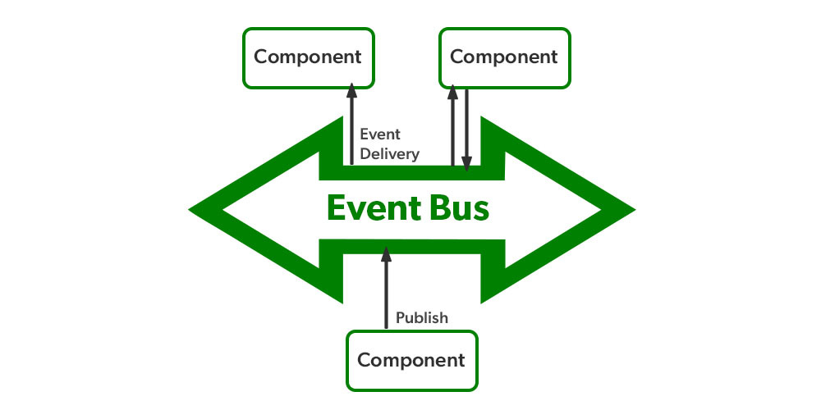
4. Event-Based Architecture:
Event-Based Architecture is almost similar to Data centered architecture just the difference is that in this architecture events are present instead of data. Events are present at the center in the Event bus and delivered to the required component whenever needed. In this architecture, the entire communication is done through events.
When an event occurs, the system, as well as the receiver, get notified. Data, URLs etc are transmitted through events. The components of this system are loosely coupled that’s why it is easy to add, remove and modify them. Heterogeneous components can communicate through the bus. One significant benefit is that these heterogeneous components can communicate with the bus using any protocol.
However, a specific bus or an ESB has the ability to handle any kind of incoming request and respond appropriately.

Slide 21
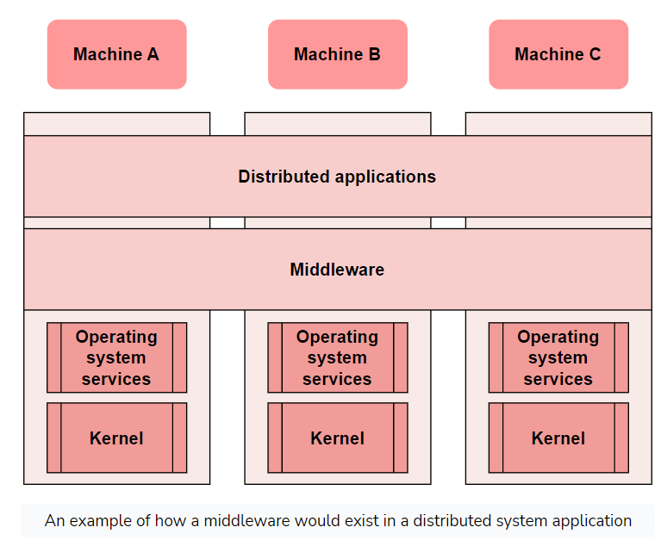
Role of Middleware in Distributed System
In a distributed system, middleware is a software component that serves between two or more applications.
Middleware usually resides between the operating system and the end user or end-user application. It provides essential features that the operating system doesn't offer. The term usually refers to large software products, such as database managers, transaction monitors, and web servers.

Slide 22
Why use middleware?
Middleware can perform numerous functions such as:
It manages connections to various backend resources. Middleware components can create connection pools to provide fast and efficient access to popular backend databases.
Second, middleware software can implement logic based on client requirements. For example, the middleware component can detect that the language header of the client browser making a particular request is set to English. As a result, queries sent to the backend will adjust to returning only English-based results.
Third, middleware is essential in concurrency, load balancing, and transaction management. It's scaled up and down to distribute incoming client requests across multiple servers, virtual machines, or cloud availability zones.
Finally, middleware plays an essential role in protecting access to backend resources. It requires a secure connection using technology such as SSL and a username/password combination or digital certificate authentication.
For example, Message-oriented middleware is designed for the purpose of transporting messages between two or more applications and is best suited for distributed applications that require transaction-oriented messaging. It could be used to monitor network traffic flows or to monitor the health of a distributed system.

Slide 23
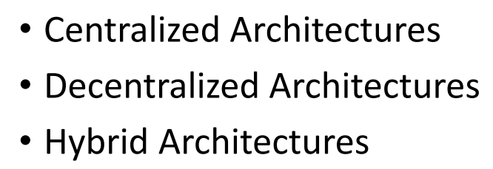
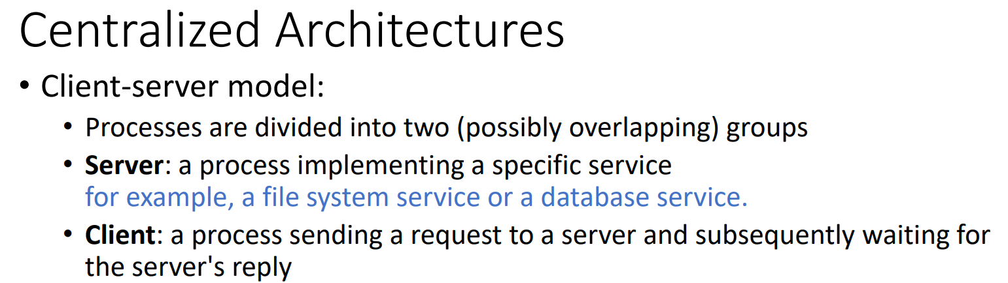
System Architectures

Slide 24
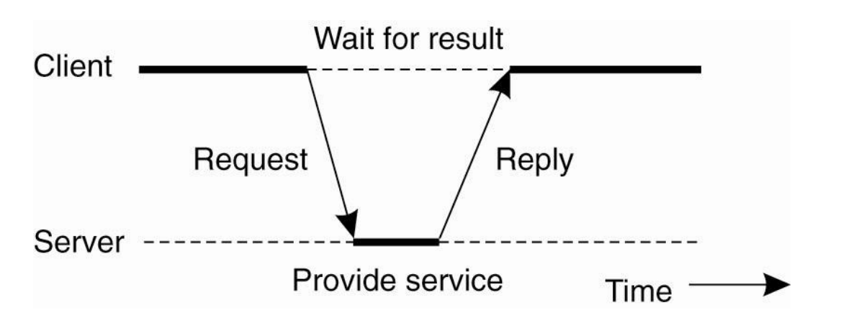

Slide 25
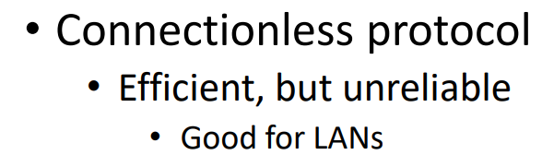
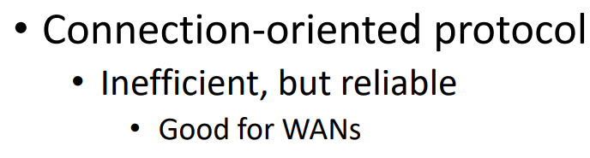
In these cases, when a client requests a service, it simply packages a message for the server, identifying the service it wants, along with the necessary input data. The message is then sent to the server. The latter, in turn, will always wait for an incoming request, subsequently process it, and package the results in a reply message that is then sent to the client
For example, virtually all Internet application protocols are based on reliable TCP/IP connections. In this case, whenever a client requests a service, it first sets up a connection to the server before sending the request. The server generally uses that same connection to send the reply message, after which the connection is torn down. The trouble is that setting up and tearing down a connection is relatively costly, especially when the request and reply messages are small.

Slide 26

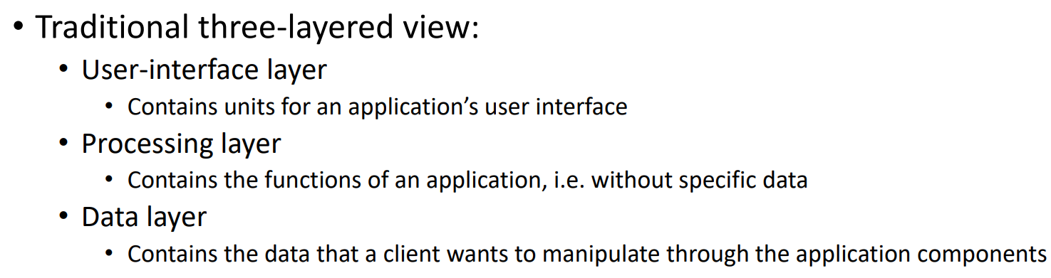
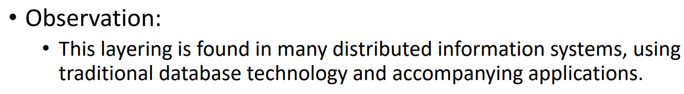

Slide 27
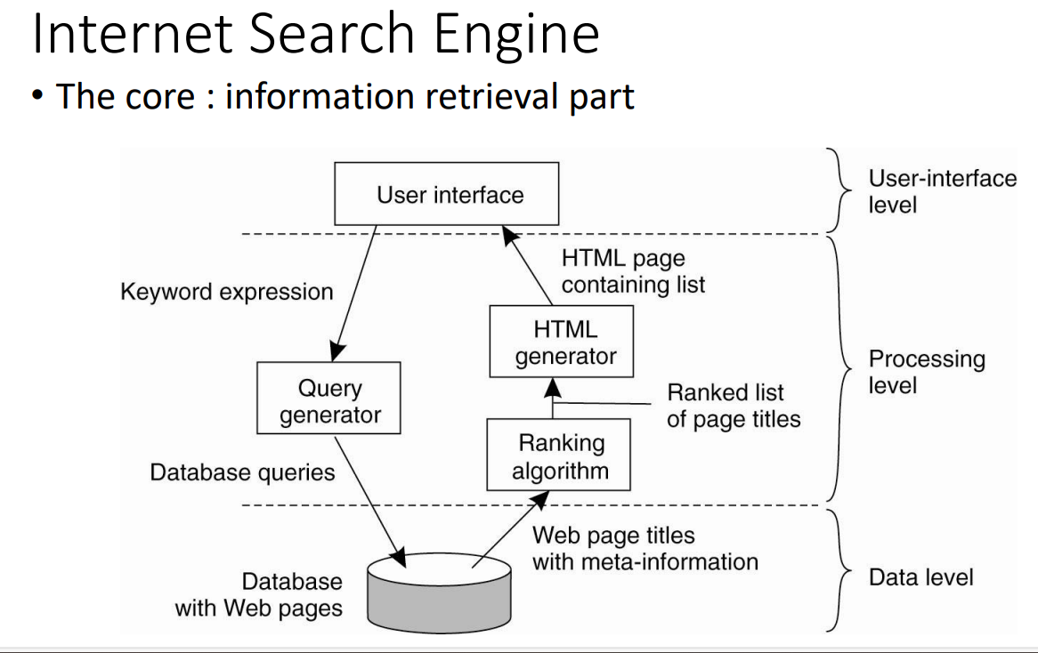

Slide 28
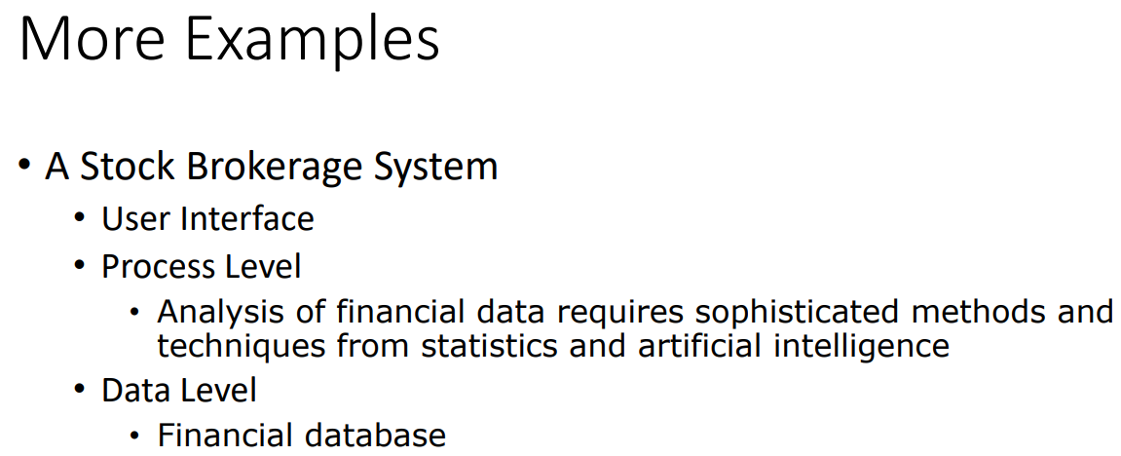
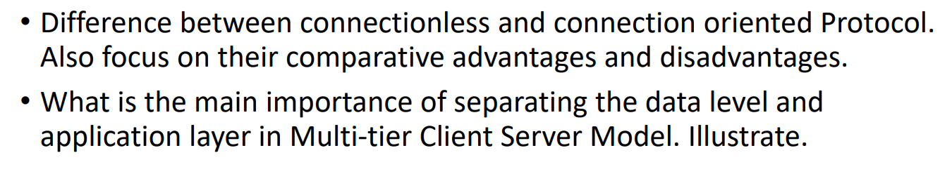

Slide 29

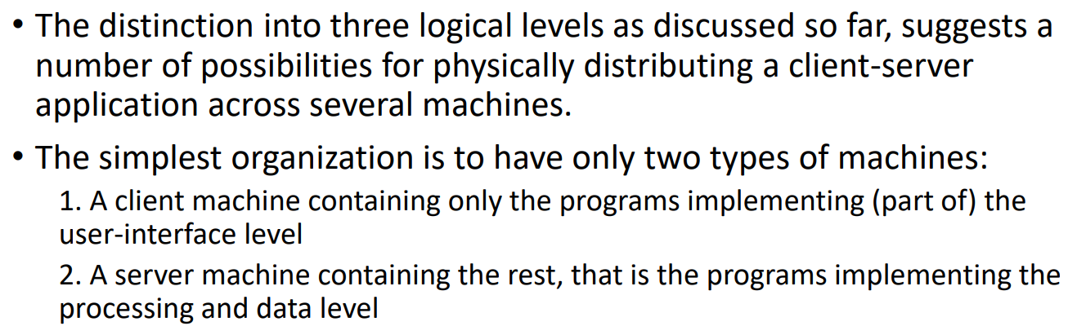
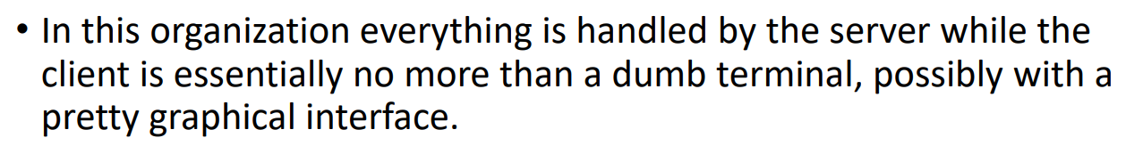

Slide 30
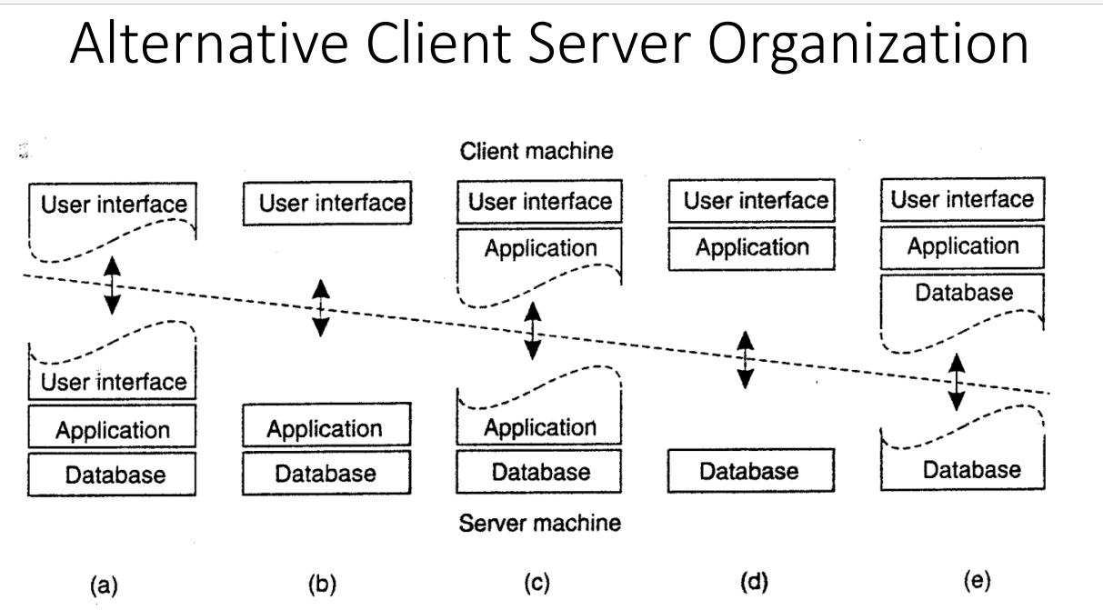

Slide 31
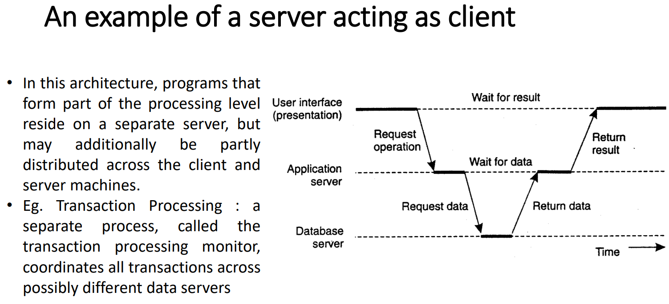

Slide 32

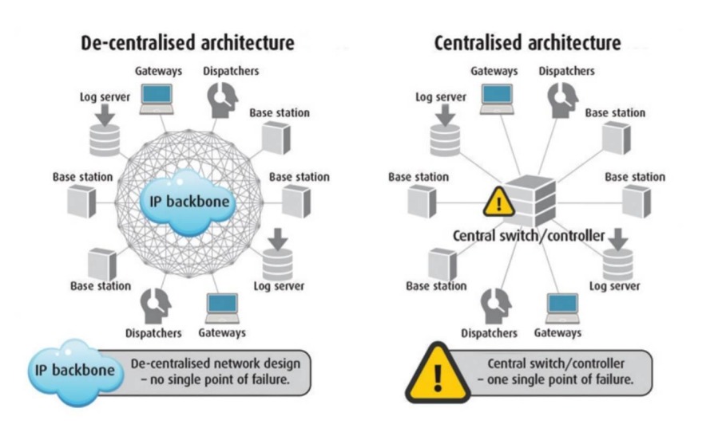

Slide 33
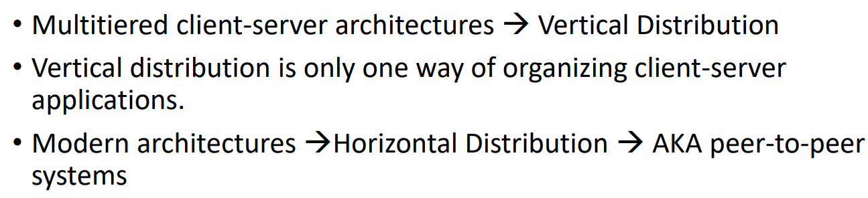
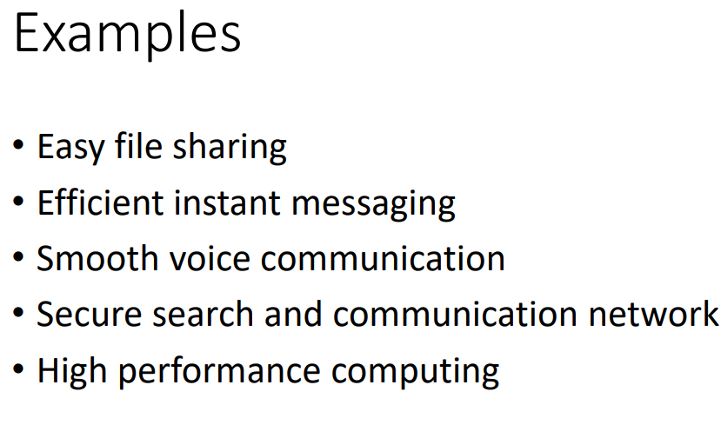
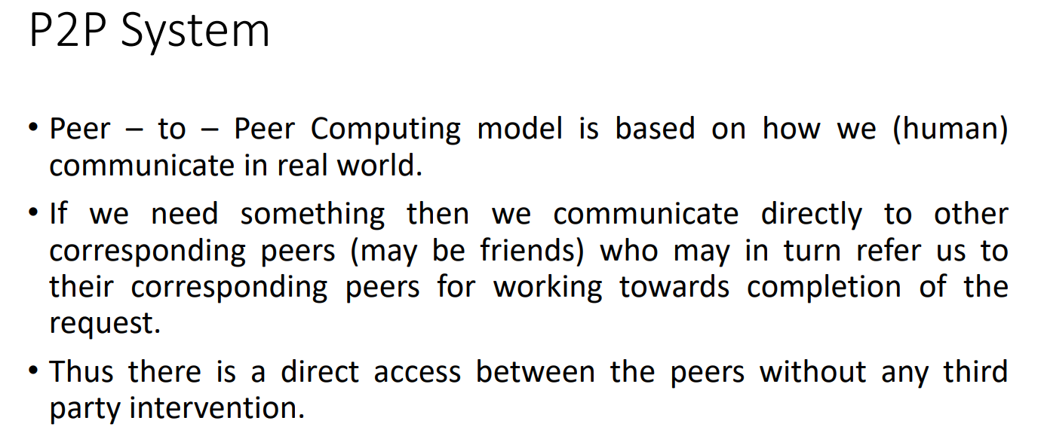

Slide 34
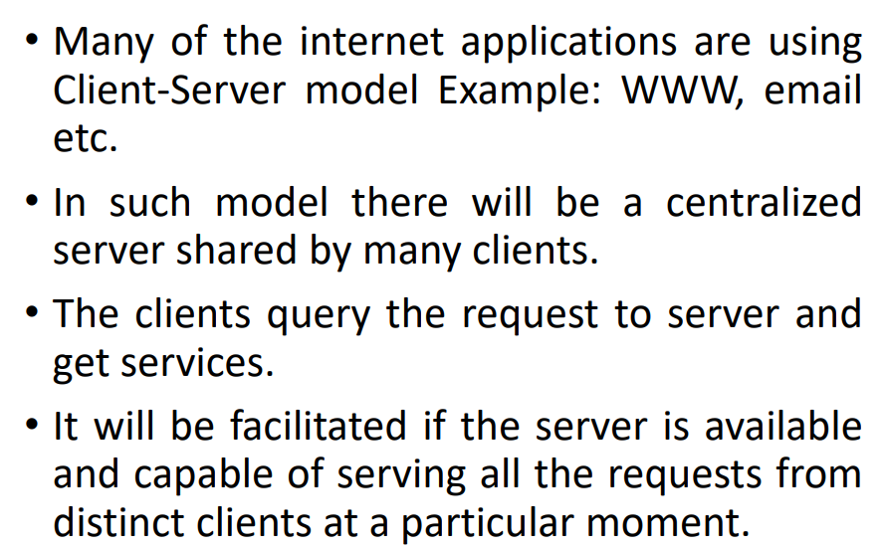
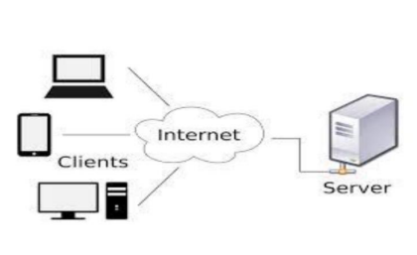
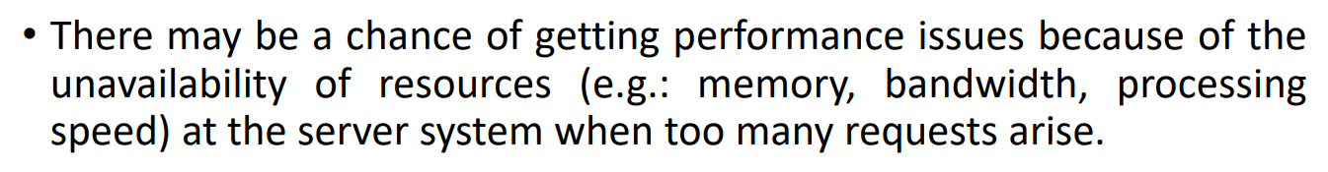

Slide 35
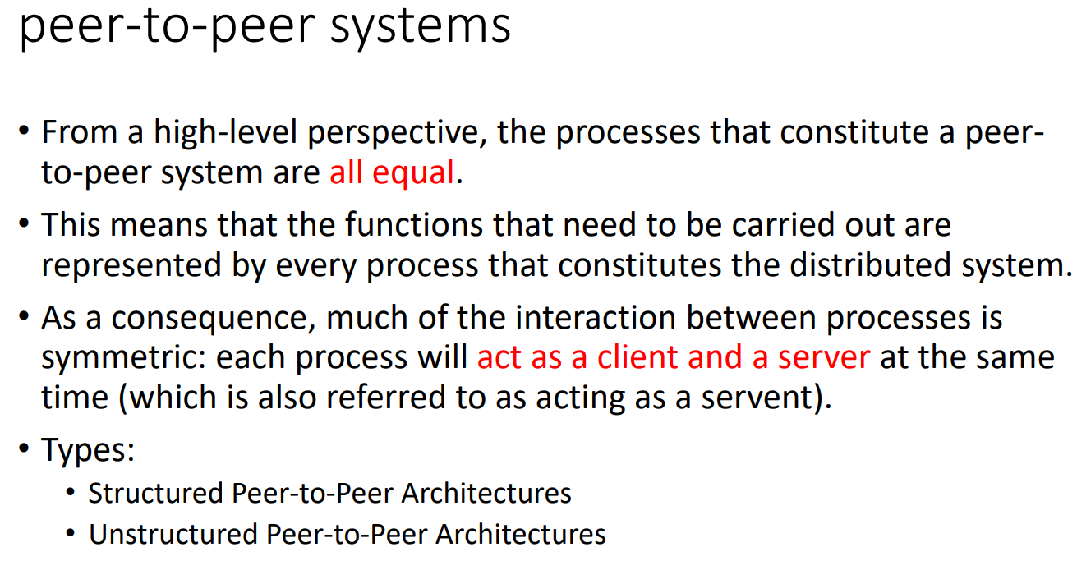

Slide 36
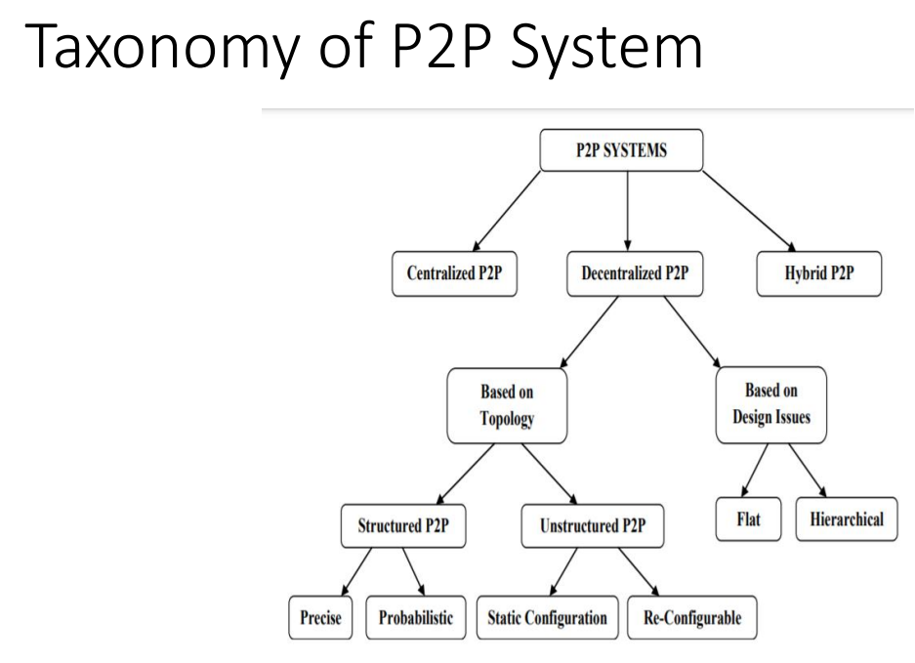

Slide 37
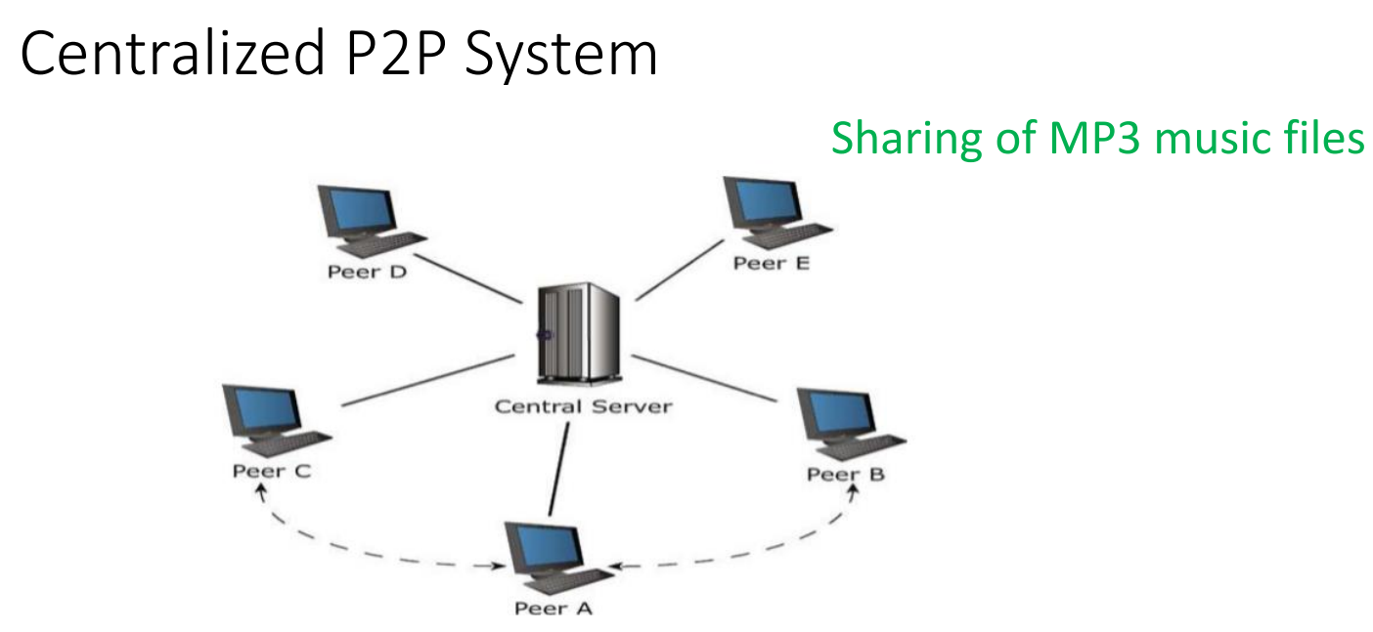

Slide 38
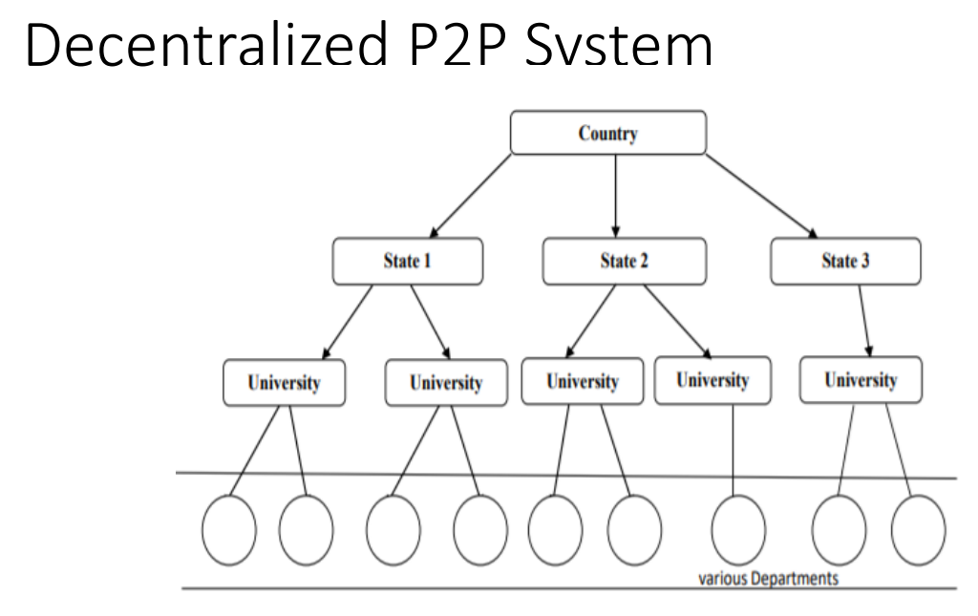

Slide 39
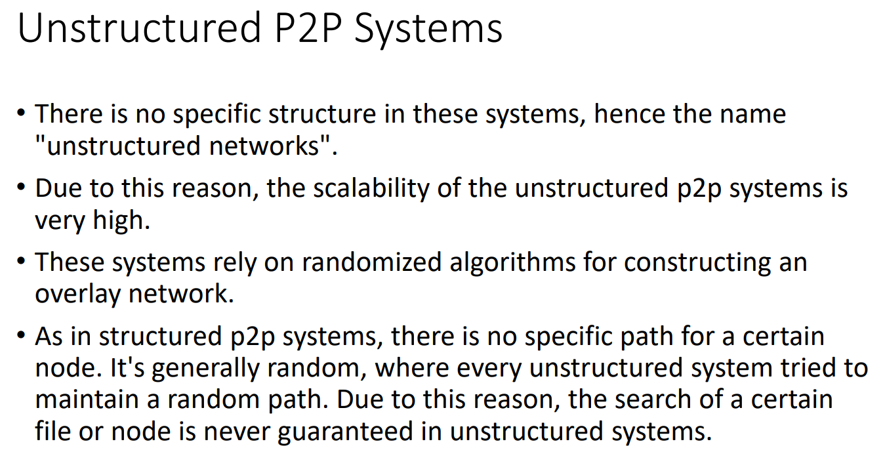

Slide 40
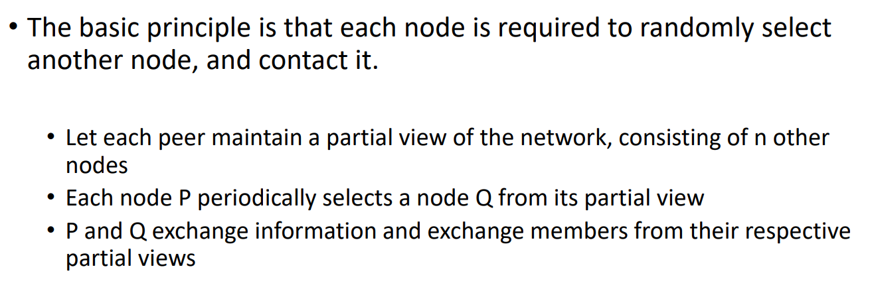

Slide 41
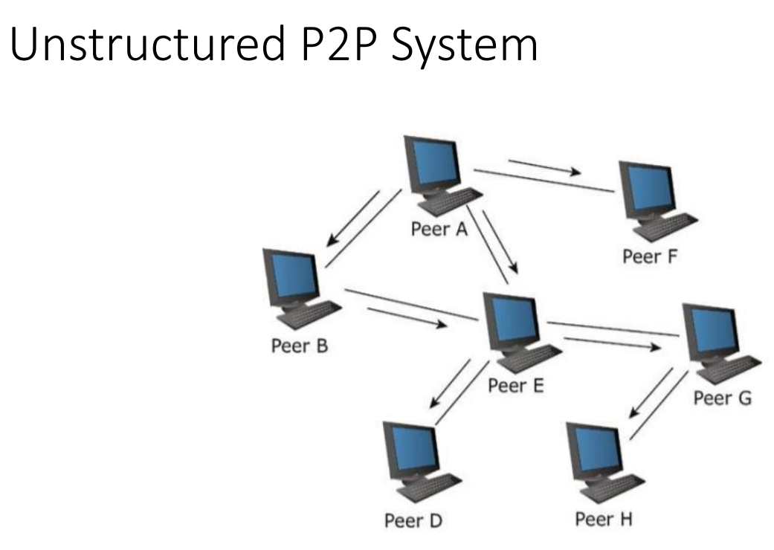

Slide 42
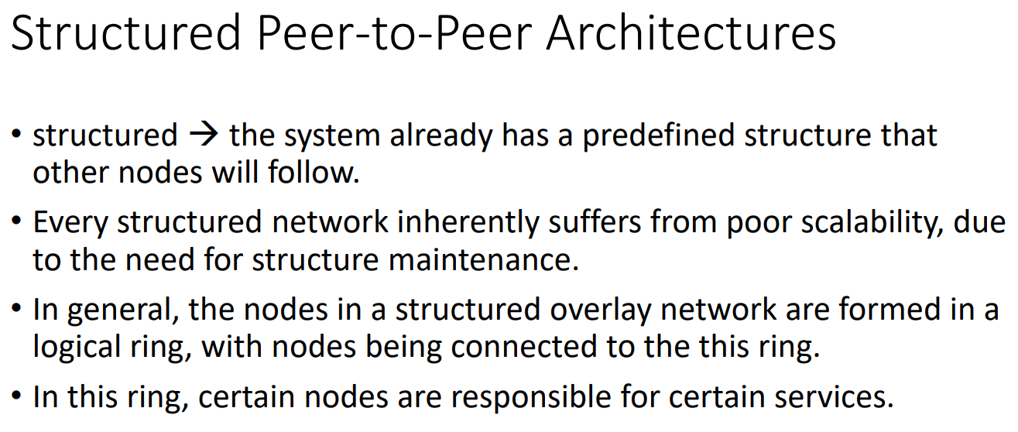

Slide 43
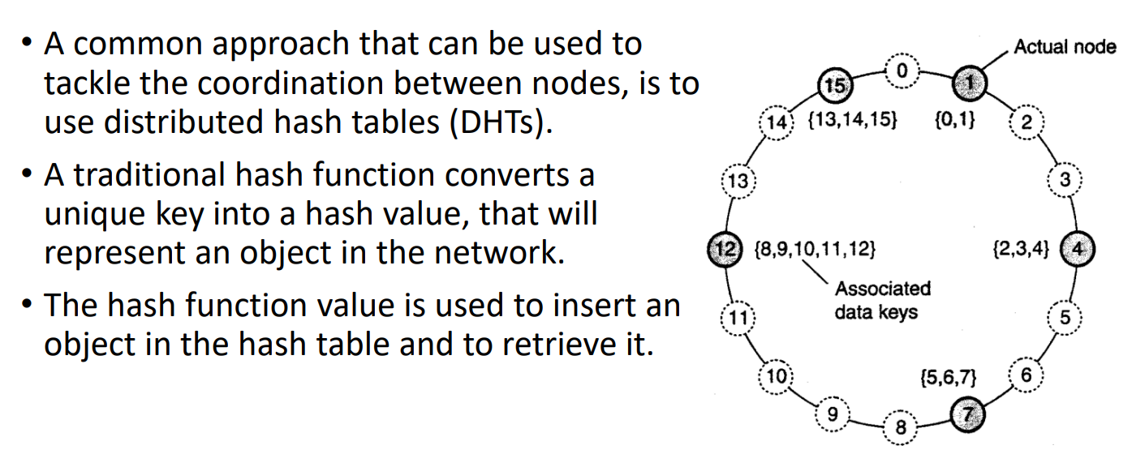

Slide 44
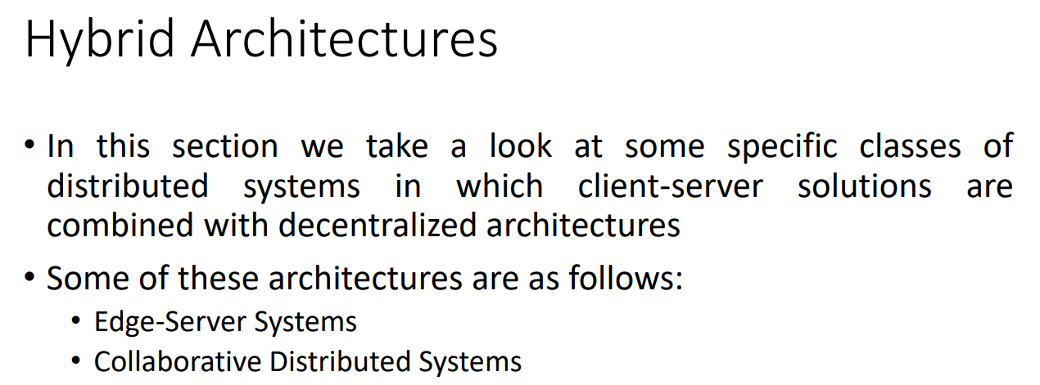

Slide 45
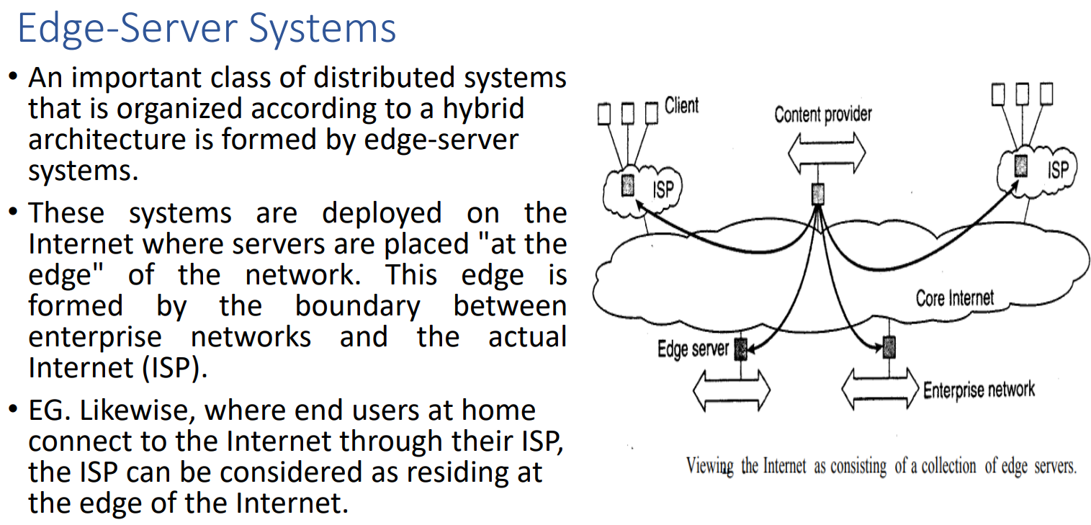

Slide 46
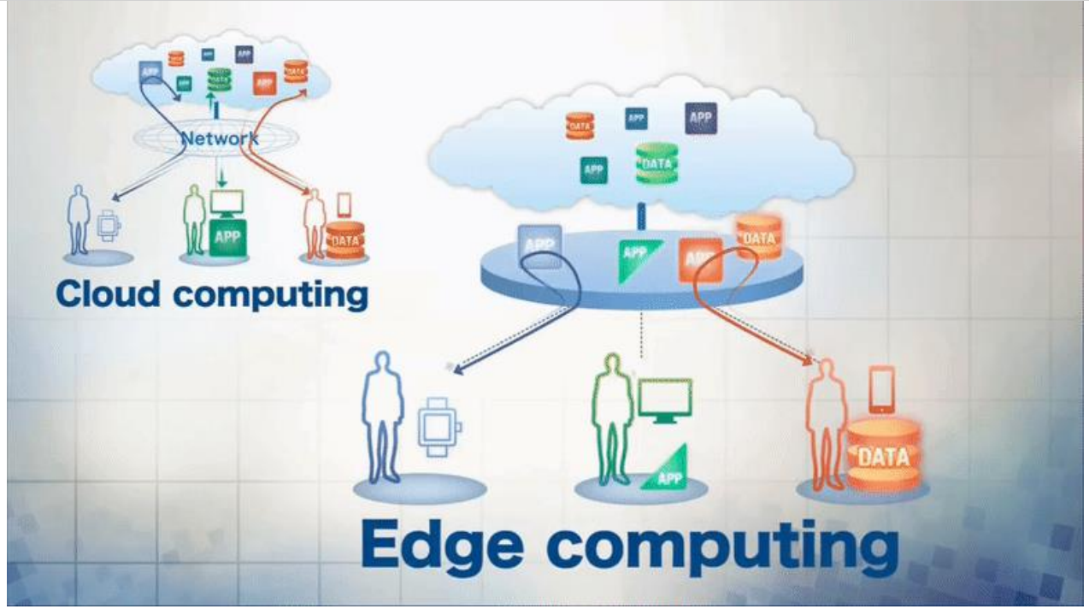

Slide 47



Slide 48


Slide 49


